Slide 1
Circuit Card #12
CMOS Inverter
By: AJ Sanderfield

Slide 2
What is a CMOS Inverter?
A CMOS inverter, or Complementary Metal-Oxide-Semiconductor inverter, is a fundamental building block in digital electronic circuits. It is a type of logic gate that performs the basic logical operation of inversion. In other words, it takes an input signal and produces the opposite (complementary) output signal. If the input is high (logic 1), the output is low (logic 0), and vice versa.

Slide 3
Where is the CMOS Inverter used?
The CMOS inverter is a building block for various digital circuits and is widely used in integrated circuits (ICs). It serves as a key component in the design of memory cells, microprocessors, and other digital systems. CMOS technology is popular in the semiconductor industry due to its low power consumption and high noise margin.

Slide 4
Other Places Include
Microprocessors and CPUs
Memory Cells (RAM)
Digital Signal Processing (DSP)
ASICs (Application-Specific Integrated Circuits)
FPGAs (Field-Programmable Gate Arrays)
Communication Systems
Clock Generation and Distribution
Digital Cameras and Image Sensors
Logic Gates and Combinational Circuits

Slide 5
What are Some Advantages?
Low Power Consumption: CMOS technology consumes minimal power when the circuit is in a stable state, making it energy-efficient.
High Noise Immunity: The complementary nature of the transistors provides high noise margins, making CMOS circuits less susceptible to noise interference.
Compact Size: CMOS circuits can be implemented in a relatively small space, allowing for the integration of numerous components on a single chip.

Slide 6
More Advantages
High Switching Speed: CMOS inverters typically exhibit fast switching speeds, allowing for quick transitions between logic states. This characteristic is crucial for the performance of digital circuits, especially in high-speed applications.
Low Heat Generation: Due to their low power consumption and efficient switching characteristics, CMOS inverters generally generate less heat compared to some other technologies. This is particularly advantageous for applications where heat dissipation is a concern, such as in portable electronic devices.
Improved Integration Levels: The compact size, low power consumption, and compatibility with silicon technology enable the integration of a large number of CMOS inverters and other components on a single chip. This high level of integration is essential for the development of complex digital systems.

Slide 7
What are some Disadvantages?
Complex Fabrication: Fabricating CMOS circuits can be more complex and expensive compared to other technologies.
Propagation Delay: While CMOS circuits generally have fast switching speeds, they may suffer from propagation delays, especially in more complex circuits.
Threshold Voltage Sensitivity: Performance can be affected by variations in threshold voltages, which may result in variations in circuit characteristics.

Slide 8
More Disadvantages
Power Consumption during Transitions: While CMOS circuits have low static power consumption, during dynamic transitions (when inputs are changing), there is a temporary increase in power consumption. This can affect the overall energy efficiency during switching periods.
Design Sensitivity: Achieving optimal performance in CMOS circuits often requires careful consideration of design parameters, such as transistor sizes, to balance power consumption, speed, and other characteristics. This sensitivity can make the design process more challenging.
Temperature Sensitivity: The performance of CMOS circuits can be influenced by temperature variations. Extreme temperature conditions may lead to changes in threshold voltages and affect the overall reliability of the circuit.

Slide 9
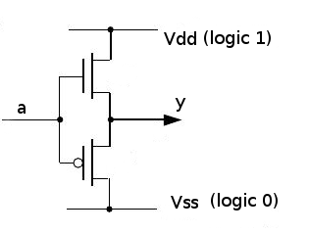
Variations
Buffered CMOS Inverter: Includes an additional buffer stage to improve performance.

Slide 10
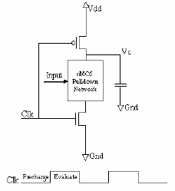
Variations
Dynamic CMOS Inverter: Utilizes dynamic logic techniques to enhance speed.

Slide 11
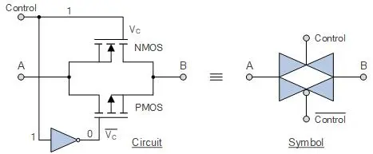
Variations
Transmission Gate Inverter: Combines transmission gates to allow bidirectional signal flow.

Slide 12
References
Storr, W. (2023, May 9). Transmission gate as a CMOS bilateral switch. Basic Electronics Tutorials. https://www.electronics-tutorials.ws/combination/transmission-gate.html
Basic dynamic CMOS circuit. | download scientific diagram - researchgate. (n.d.). https://www.researchgate.net/figure/Basic-dynamic-CMOS-circuit_fig11_300375762
Agarwal, T. (2022, January 27). CMOS inverter : Circuit, working, Characteristics & Its Applications. ElProCus. https://www.elprocus.com/cmos-inverter/
Agarwal, T. (2022a, January 27). CMOS inverter : Circuit, working, Characteristics & Its Applications. ElProCus. https://www.elprocus.com/cmos-inverter/#:~:text=A%20CMOS%20inverter%20is%20a%20FET%20(field%20effect%20transistor)%2C,generating%20data%20n%20small%20circuits.
Uyemura, J. P. (1992, January 1). The CMOS inverter. SpringerLink. https://link.springer.com/chapter/10.1007/978-1-4615-3620-8_3#:~:text=A%20standard%20CMOS%20inverter%20is,properties%20of%20CMOS%20logic%20circuits.

